Slide 1

Graph-Based Personalized Memory for LLM Agents
ICKG 2026
Dac Duy Anh Nguyen, Zhangchi Qiu, Shigeng Chen, Alan Wee-Chung Liew
Presenter: Dac Duy Anh Nguyen
1

Slide 2
Contributions
01
A lifecycle taxonomy of Graph-based Personalised Memory for agents, covering memory representation, evolution, retrieval and evaluation.
Representation
Evolution
Retrieval
Evaluation
02
03
04
Benchmark summary.
Timely review.
Open research directions.
Disclosure: presentation content is fully written by the presenter, final layout is edited by AI.
2

Slide 3





Background
LLM agents are serving as personal assistants
Their recommendations and responses are shaped by human behaviours.
OpenClaw
Hermes
Grok Bot
Storing all interactions in the context window is impractical
LLM context windows are finite
Memory is mostly stored as text files or vector stores.
Memory relationships, evolution, deletion are not explicitly expressed.
Knowledge Graph (KG) is a good candidate to address these limitations while keeping the memory interpretable and auditable.
3

Slide 4

Memory elements — Node
MEMORY REPRESENTATION
Evidence node
Fact node
original interaction records with little to no format modification.
extracted atomic assertion or entity.
E.g. “Tom went to Shenyang” or “Tom”
E.g. “Tom went to Shenyang for the ICKG conference and met a lot of experts in his field”
Abstraction node
Domain-specific node
synthesized summary observations that form higher-level user models.
dedicated to storing entities about one particular topic, such as sports, prescriptions or family members.
E.g. “Tom’s China trip for ICKG conference”
These memory nodes are only categorized by function. The specific content or format inside the nodes can vary vastly.
5

Slide 5




Memory elements — Relation
MEMORY REPRESENTATION
Temporal
encodes event order or progression.
E.g. “Tom went to Shenyang” → “Tom met a lot of experts in his field”
connects assertions or abstractions to source evidence.
Provenance
E.g. “I just finished my 2-day ICKG conference. There are so many talented people at ICKG, mate.” – Tom said -evidence_for→ “Tom attended 2-day ICKG conference”, “Tom met many experts”
links contextually or semantically related memories.
Associative
E.g. “Tom gave a presentation on Knowledge Graph” ↔ “Tom discussed with Tian how to improve Knowledge Graph memory efficiency”
Domain-specific
encodes task-specific relationships
E.g. (care assistant) “Nurse Anna” -supervises→ “Tom: 8am medication”
6

Slide 6
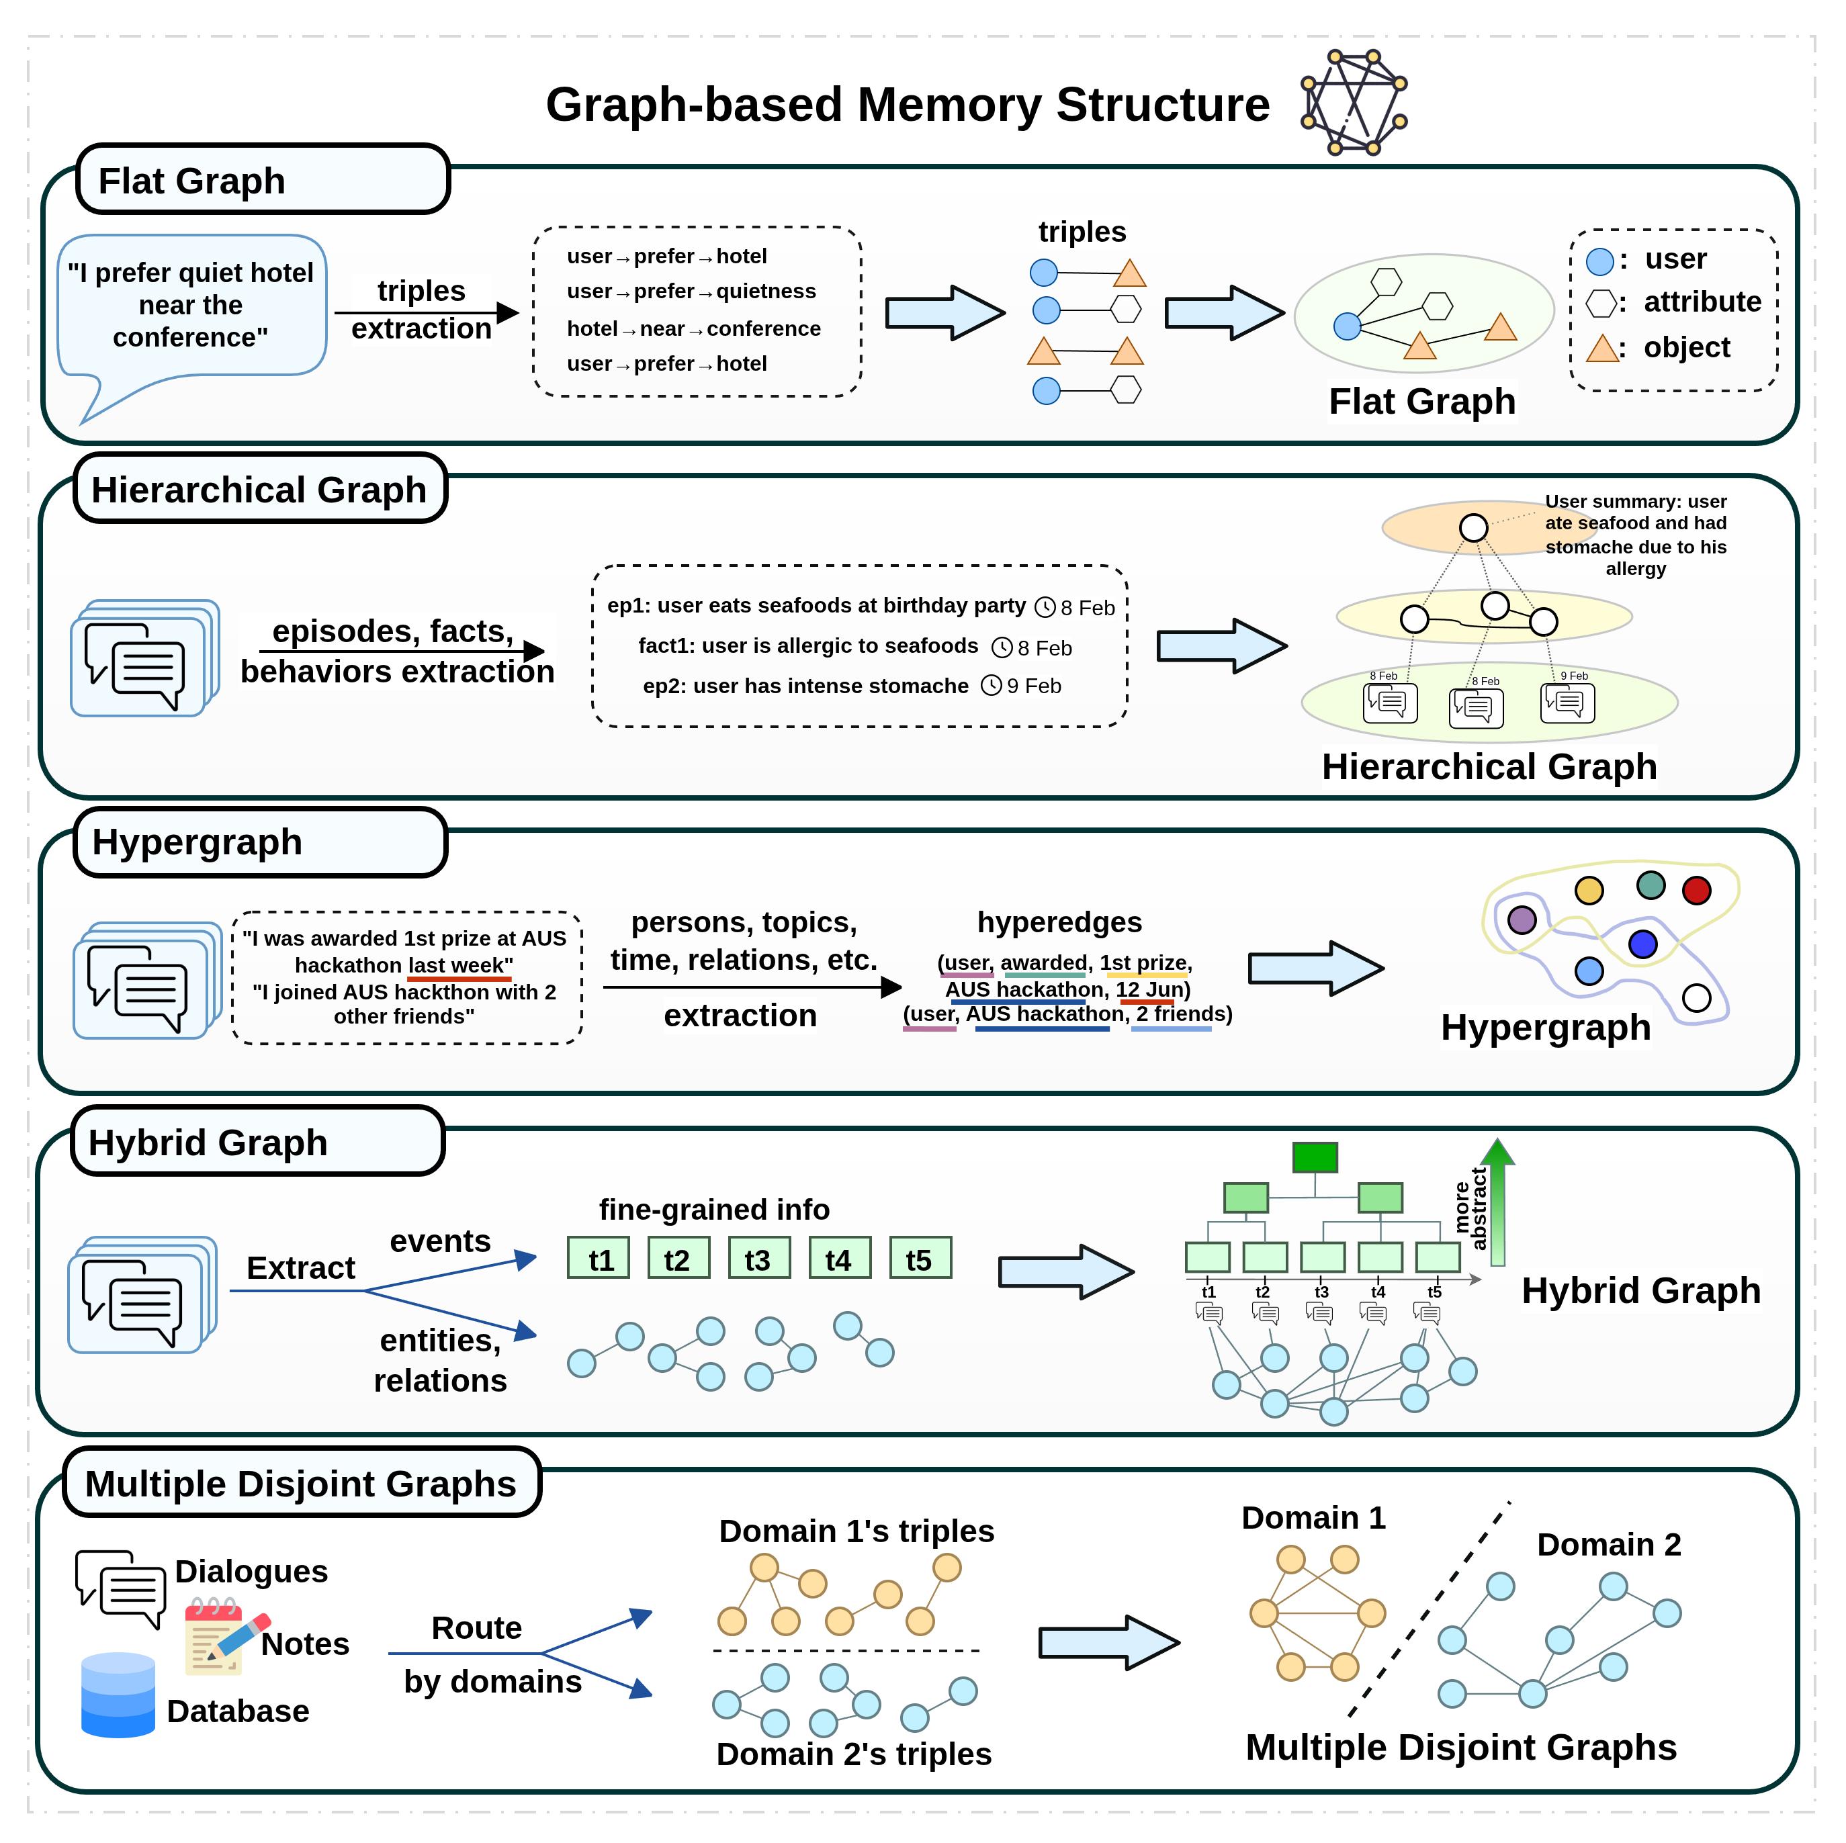
Memory structures
MEMORY REPRESENTATION
1
Flat graph
2
Hierarchical graph
3
Hypergraph
4
Hybrid graph
5
Multiple distinct graphs
8

Slide 7
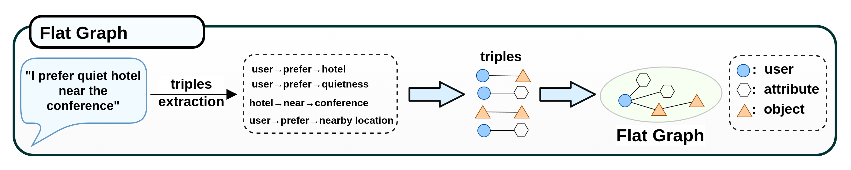
Flat graph
MEMORY STRUCTURES
1 Flat
2 Hierarchical
3 Hyper
4 Hybrid
5 Multiple
Flat Graph stores facts, entities, preferences and relations without explicit abstraction layers or levels
9

Slide 8
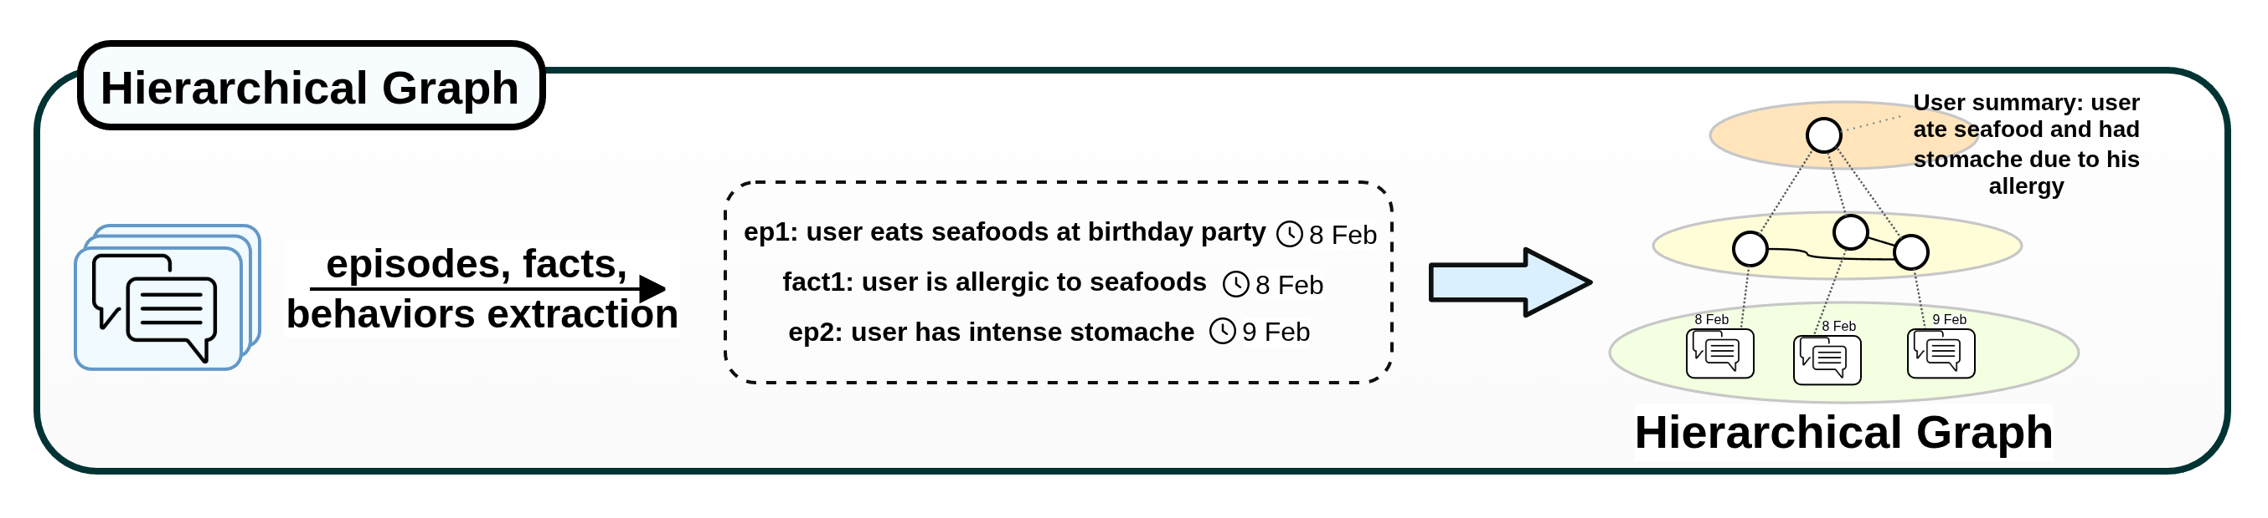
Hierarchical graph
MEMORY STRUCTURES
1 Flat
2 Hierarchical
3 Hyper
4 Hybrid
5 Multiple
Hierarchical graph organizes user memories into multiple layers at different levels of specificity.
10

Slide 9
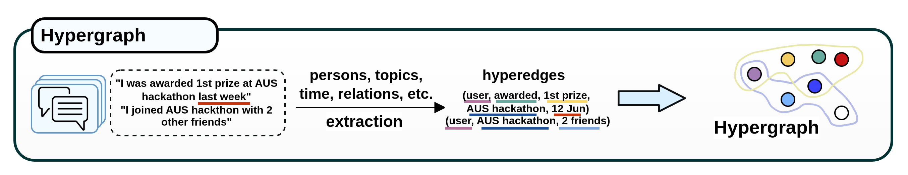
Hypergraph
MEMORY STRUCTURES
1 Flat
2 Hierarchical
3 Hyper
4 Hybrid
5 Multiple
Hypergraph preserves joint context whose meaning depends on several connected elements.
11

Slide 10
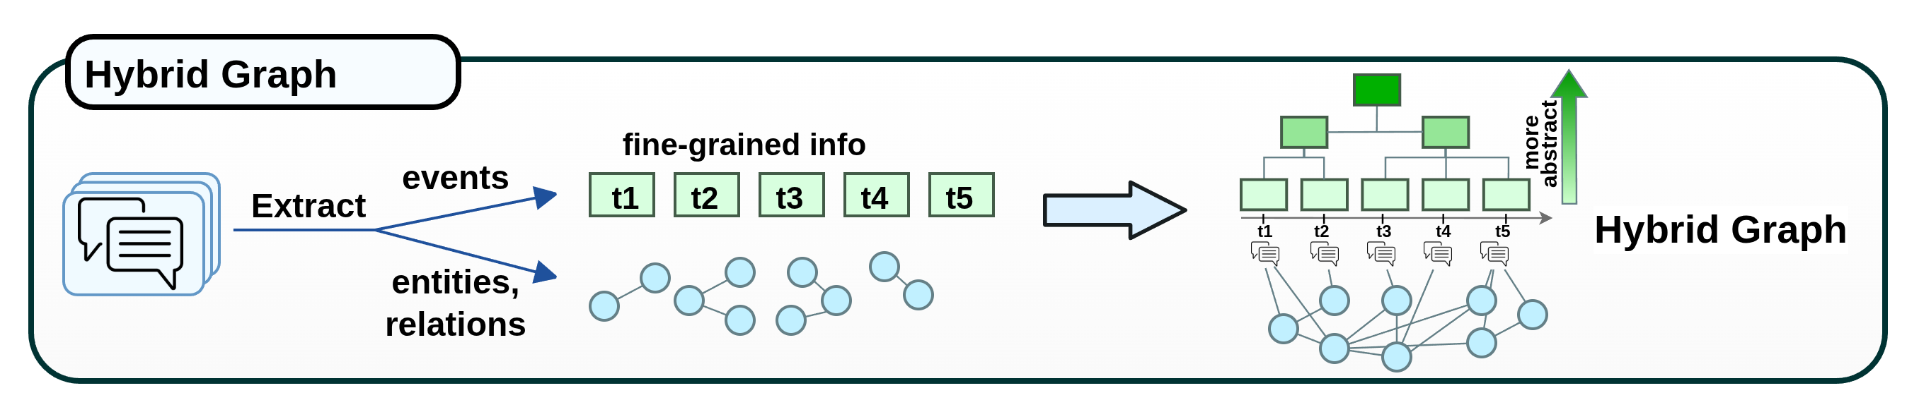
Hybrid graph
MEMORY STRUCTURES
1 Flat
2 Hierarchical
3 Hyper
4 Hybrid
5 Multiple
Hybrid Graph distributes the memories across graph topology and a complementary non-graph substrate such as a tree
12

Slide 11
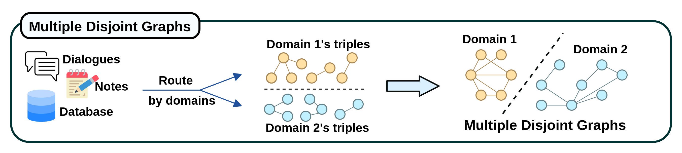
Multiple distinct graphs
MEMORY STRUCTURES
1 Flat
2 Hierarchical
3 Hyper
4 Hybrid
5 Multiple
Multiple distinct graphs split user memories across separate graph instances, each of which serves a distinct, specialized function
13

Slide 12
Discussion
MEMORY REPRESENTATION
Memory representation determines what evidence is retained and how later lifecycle operations use it.
Evidence nodes takes up a lot of storage.
→ Does the use case require provenance?
Abstraction-centered designs compact user memories but may discard helpful fine-grained information
Hierarchical and hybrid graphs require information consistency across levels
→ Additional burden to propagate changes
→ A good balance is needed.
14

Slide 13
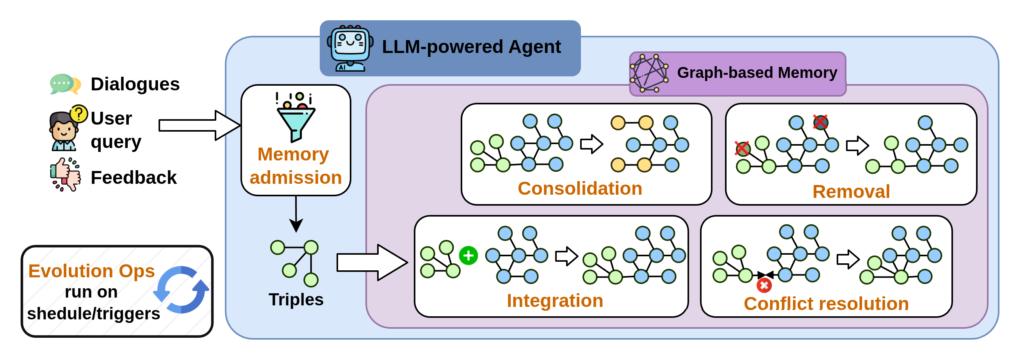
Memory evolution
MEMORY EVOLUTION
maintains an up-to-date memory systems
15

Slide 14
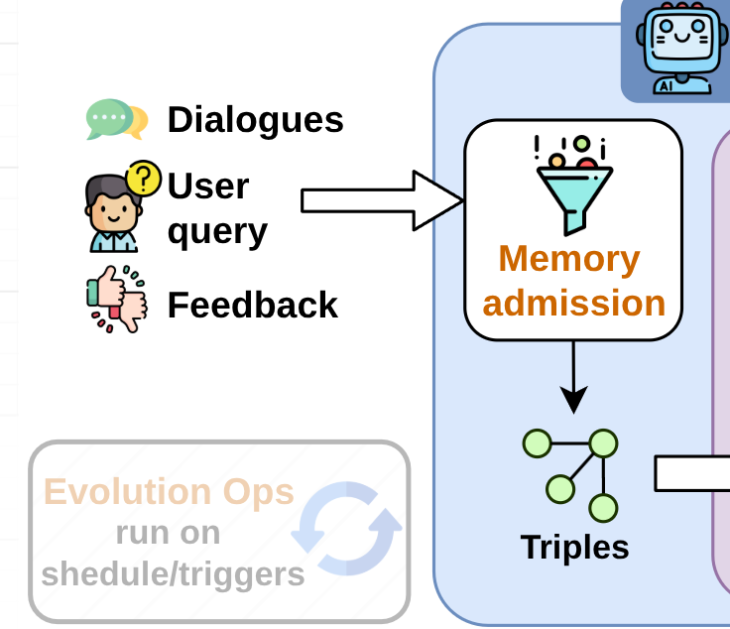
Memory admission
MEMORY EVOLUTION
1 Admission
2 Integration
3 Conflict
4 Consolidation
5 Removal
Decides whether incoming evidence should be admitted to become persistent memory.
e.g. retain user-persona-relevant content
Can be triggered by user feedback, policy, etc.
Over-admission
Under-admission
risks polluting memory with transient information
may discard useful information
16

Slide 15
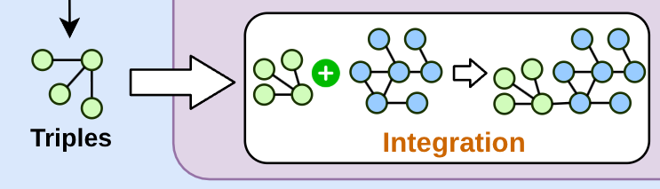
Memory integration
MEMORY EVOLUTION
1 Admission
2 Integration
3 Conflict
4 Consolidation
5 Removal
Attaches evidence to existing graph structure
17

Slide 16
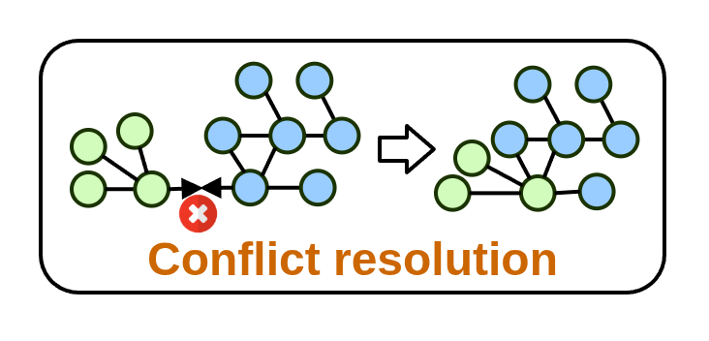
Conflict resolution
MEMORY EVOLUTION
1 Admission
2 Integration
3 Conflict
4 Consolidation
5 Removal
Needed when incoming evidence changes the validity of a stored memory
3 CONFLICT TYPES
1
2
3
Temporal supersession
User correction
Contextual coexistence
valid in different contexts.
18

Slide 17
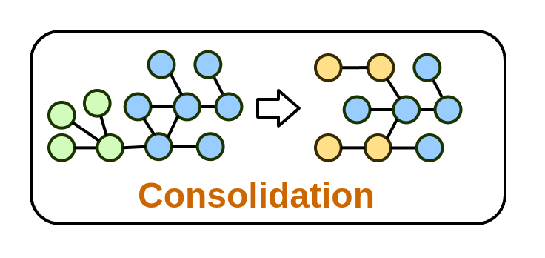
Consolidation
MEMORY EVOLUTION
1 Admission
2 Integration
3 Conflict
4 Consolidation
5 Removal
Reorganizes and merges accumulated memory after multiple writes.
SERVES AS
deduplication
summarization
restructuring
archival
functions
19

Slide 18
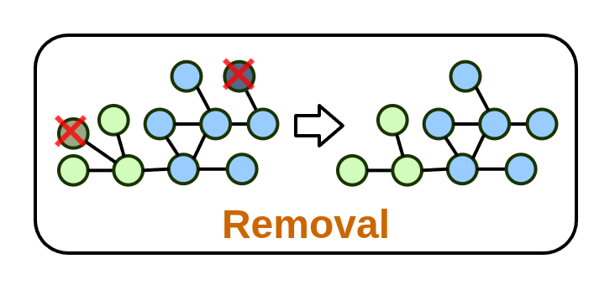
Memory removal
MEMORY EVOLUTION
1 Admission
2 Integration
3 Conflict
4 Consolidation
5 Removal
Takes 2 distinct forms: Forgetting and Deleting
Forgetting
Deleting
reduces a memory’s exposure, resolution, weight or retrieval likelihood while memory content stays unchanged
either removes memories completely or deactivates them (i.e. soft deletion), excluding them from retrieval unless explicitly requested.
20

Slide 19
Discussion
MEMORY EVOLUTION
These operations often happen simutaneously.
Must be done with care as memories are tightly connected.
21

Slide 20
Memory retrieval
MEMORY RETRIEVAL
maps a user request to a bounded subset of memories.
3 MECHANISMS
1
2
3
Similarity-based retrieval
Structure-based retrieval
Agentic retrieval
They can be used individually or together.
22

Slide 21
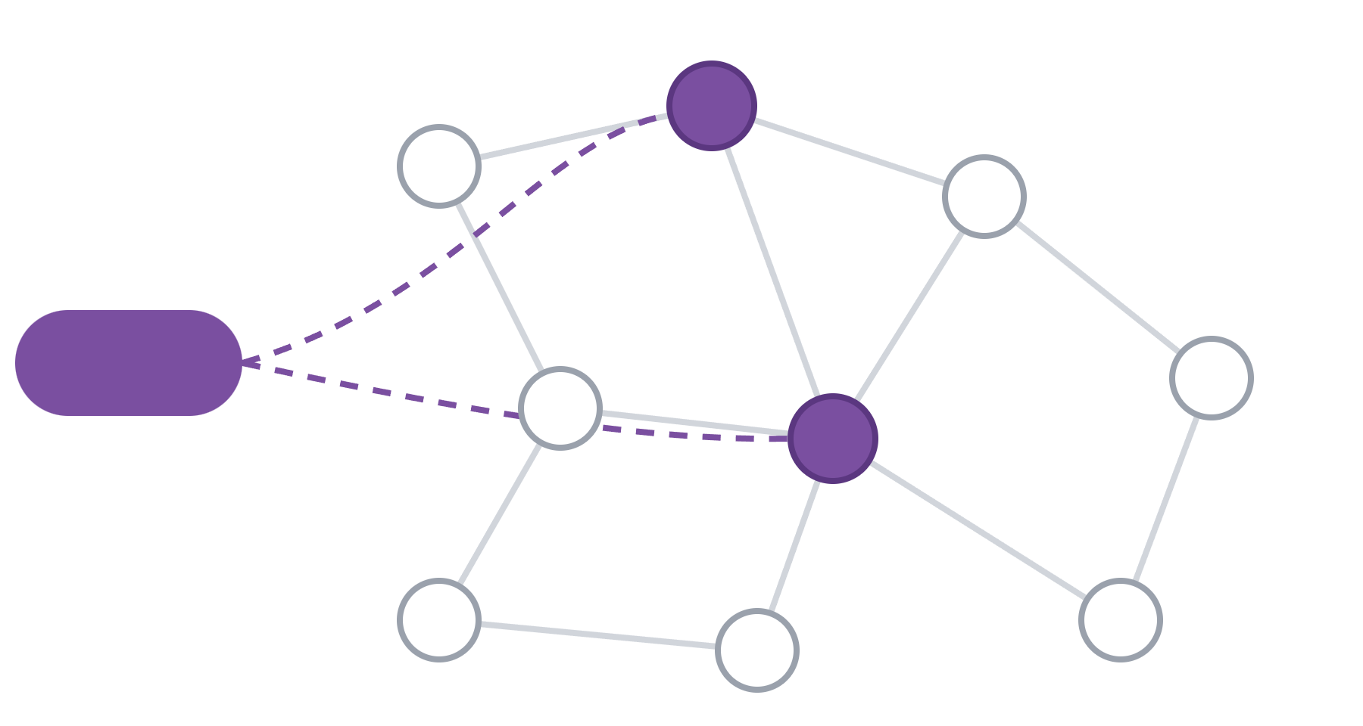
Similarity-based retrieval
MEMORY RETRIEVAL
1 Similarity
2 Structure
3 Agentic
lexical / keyword / dense-vector matching.
commonly used for generating anchor candidates to expand in the KG.
query
Searching based on semantic proximity alone may miss evidence connected through temporal, causal, entity or abstraction relations.
anchor candidates
not matched
23

Slide 22
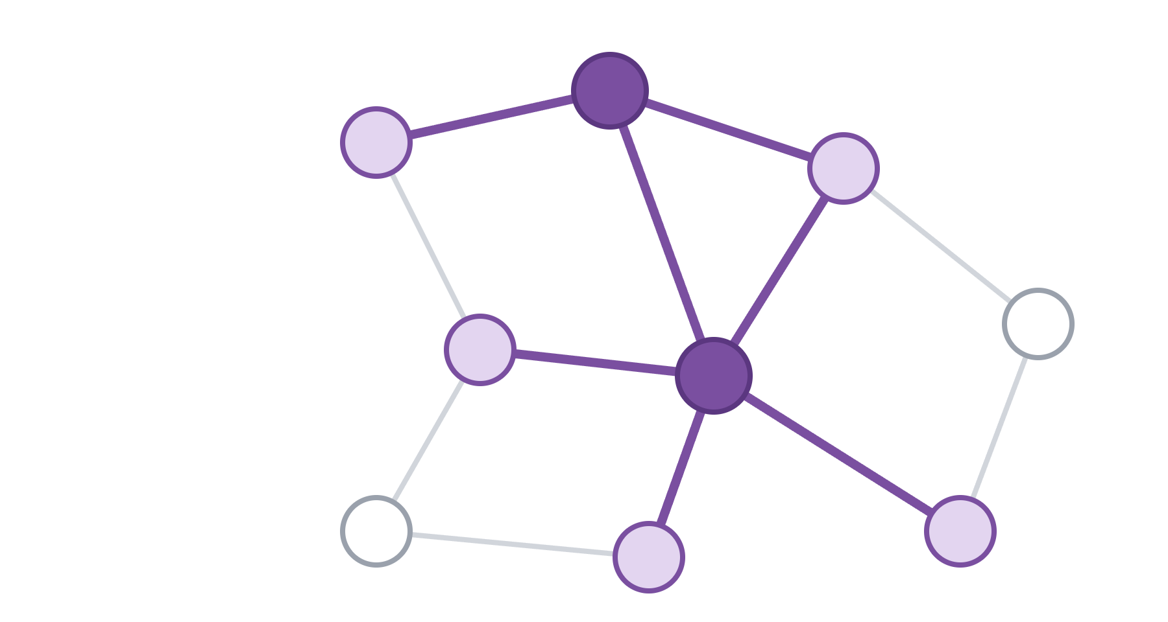
Structure-based retrieval
MEMORY RETRIEVAL
1 Similarity
2 Structure
3 Agentic
leverages graph structure to expand initial candidates via KG edges.
The expansion can complement the missing evidence provided by similarity-based retrieval.
anchor candidates
expanded via KG edges
24

Slide 23
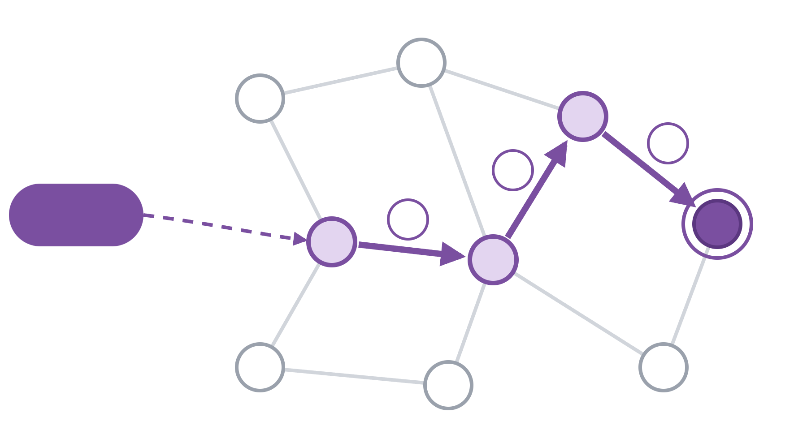
Agentic retrieval
MEMORY RETRIEVAL
1 Similarity
2 Structure
3 Agentic
leverages LLM intelligence to interpret the user query.
3
2
LLM agent
1
steers graph exploration, stopping and routing dynamically based on intermediate evidence.
stop
visited hop by hop
agent decides to stop
25

Slide 24
Discussion
MEMORY RETRIEVAL
The 3 memory lifecycle operations (retrieval strategy, evolution and graph structure) should be co-designed since they are highly dependent on each other.
The 3 mechanisms can be combined in a retrieval pipeline.
Similarity
+
Structure
+
Agentic
26

Slide 25
Evaluation
EVALUATION
Current benchmarks focus on downstream performance:
answer correctness
supporting-evidence identification
inference cost
user modelling state
They fall into 3 groups:
Group | Benchmarks
Conversational, long-horizon recall and retrieval | LoCoMo, LongMemEval
Personalization and user-state modeling | PersonaMem, PersonaMem-v2, RealMem, PerLTQA
Graph structure and evolution | EngramaBench, EvoMemBench, EvoArena, ActMemEval, ATM-Bench, StructMemEval
27

Slide 26
Discussion
Can it scale for lifelong personal memory (with up to billions of interaction tokens)?
Can it support multimodal input?
No part of the personalized memory lifecycle is more important than the rest. Every part should be co-designed.
→ This can be a challenge at the design stage, or an opportunity to re-think memory systems.
28

Slide 27
Observations/insights since publishing this survey
AUTHOR CORNER
Nodes
Scalability
can also be structure- or format-rich text. The same goes for edges.
O(n)
O(1)
current memory systems
human memory
E.g. MemCog [1] has a semi-graph structure with hyperlinks connecting one text file to another (think Obsidian) → more coherent memory
Current memory systems’ storage scales approximately O(n) with input data. Human memory scales O(1) with input data – a reasonable baseline?
E.g. MeMo [2] offers a glimpse of this by training a small language model to serve as memory.
[1] Z. Li, X. Fan, F. Li, and W. Que, “MemCog: From memory-as-tool to memory-as-cognition in conversational agents,” 2026, arXiv:2605.28046.
[2] R. W. H. Quek et al., “MeMo: Memory as a model,” in Proc. 43rd Int. Conf. Mach. Learn. (ICML), 2026.
29

Slide 28
Observations/insights since publishing this survey
AUTHOR CORNER
Towards portable LLMs: essential in the medical sector, with its sensitive data.
There are still gaps in other domains with their unique challenges.
RAW-RAG [4] challenges existing approaches with graph-based memory systems.
Do knowledge graphs provide superior performance or address your use case’s pain points (e.g. provenance)?
E.g. medical – MedMemoryBench [3]
[3] Y. Wang et al., “MedMemoryBench: Benchmarking agent memory in personalized healthcare,” in Adv. Neural Inf. Process. Syst. (NeurIPS), Datasets and Benchmarks Track, 2026.
[4] Z. Bao, S. Zhang, H. Zhang, S. Lou, M. Wen, and M. Luo, “Is complex agentic memory always needed? Naive RAG is stronger than we thought,” 2026, arXiv:2610.30755.
30

Slide 29

Thanks for listening!
All relevant resources:
rodonguyen.dev/ickg26
Disclosure: presentation content is fully written by the presenter, final layout is edited by AI.
31

